Slide 1
How to read a scientific paper
The AIC Method
Christine Kang (she/her)
csykang@uw.edu
From: www.raulpacheco.org/2017/01/finding-the-most-relevant-information-in-a-paper-when-reading-a-three-step-method/

Slide 2
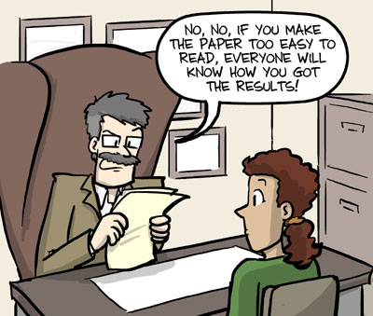
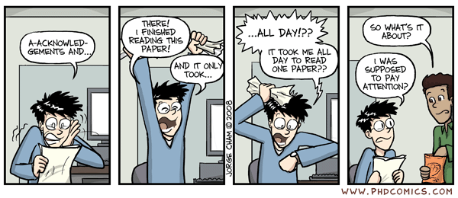
A lot of papers are written in scientifically precise, but super technical, jargon-y language.

Slide 3
This can make them boring and hard to read.

Slide 4
(2 min) Please unmute yourself & share:
How do you figure out what a paper/article is about?

Slide 5
The AIC Content Extraction Method:
First, read the:
Abstract
Introduction
Conclusion
Then look at the figures and read the rest of the paper.

Slide 6
The Abstract:
From: chemistrycommunity.nature.com/posts/43071-how-to-write-an-abstract
What: Very brief, summary of what they did and why.
Why: Convince readers to read the whole paper.
How: Abstracts have 5 parts:
Introduction
What does the field look like? (~2 sentences)
Problem/Objective
Why did the study happen? “However...” (1 sentence)
“Here we show…”
What is their main finding? What did they accomplish? (1 sentence)
Main Results & Conclusions
What are their results? (3-5 sentences)
Implications
Why this is important/significant/useful? (1-2 sentences)

Slide 7
The Introduction:
What: Provides context (“What”) and the reason (“Why”) for the paper.
After reading the introduction, you should be able to answer:
What is the context of this research?
What have other people done?
What hasn’t been done yet?
Why are the authors doing it?
Why did they bother to spend tons of time and $$$ to solve this problem/do this thing?
Sometimes, the answer is: “because they can, and nobody else has managed to do it yet.”

Slide 8
The Conclusion:
What: Gives you a summary of what’s been done and what their findings mean.
After reading the conclusion, you should be able to answer:
What have the researchers found/accomplished?
To what extent have the researchers succeeded in addressing the problem they stated in the Introduction?
What do their findings mean?
What are potential next steps for the authors/other researchers? What is still left to do?
What can the researchers do next now that they’ve completed this work?
How do the findings of this paper contribute to scientific knowledge as a whole?

Slide 9
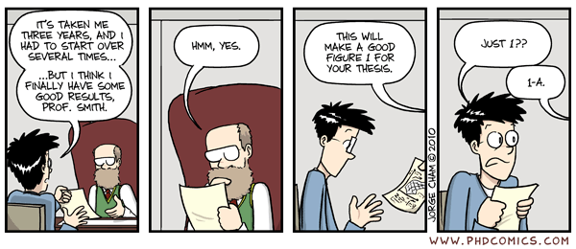
...Then read the rest of the paper.
Figures -> Data/Results -> Methods

Slide 10
Other general tips:
People read papers for many different reasons, so ymmv.
Print it off, then write all over it.
Look words up as you go and write their definitions in the margins.
If something confuses you, write it down as a question in the margins.
Open up the supplemental materials and if the article references something in the supplement (“Supplementary Figure 1”), look at it as you go.
Any tips from the other instructors?

Slide 11
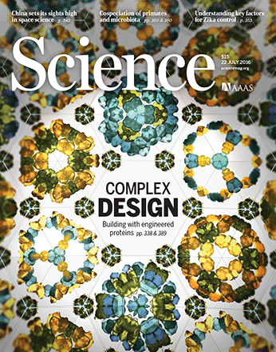
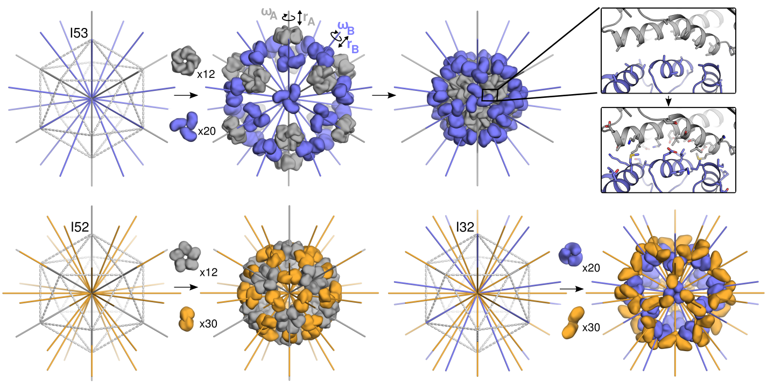
Homework
Read and analyze: Bale et al., Accurate design of megadalton-scale two-component icosahedral protein complexes. Science (2016)

Slide 12
Homework
Read and analyze: Bale et al., Accurate design of megadalton-scale two-component icosahedral protein complexes. Science (2016)
From the abstract:
“...we report the computational design and experimental characterization of co-assembling, two-component, 120-subunit icosahedral protein nanostructures… Electron microscopy, small-angle x-ray scattering, and x-ray crystallography show that 10 designs spanning three distinct icosahedral architectures form materials closely matching the design models
Do you know all of these terms? What are your expectations for the data in the paper?

